Slide 1
Wheel of Fortune®
Creator User Guide
©2021 The Game Agency, LLC Confidential Information | Subscribers Only | All Rights Reserved
Presentation ©2017 – 2021 The Game Agency LLC. All trade names, trade dress, trademarks, artwork, and other content are trademarks and/or copyright material of their respective owners. The Training Arcade is a registered trademark of The Game Agency LLC. "Wheel of Fortune®" and "America's Game®" are registered trademarks of Califon Productions, Inc. All rights reserved.

Slide 2
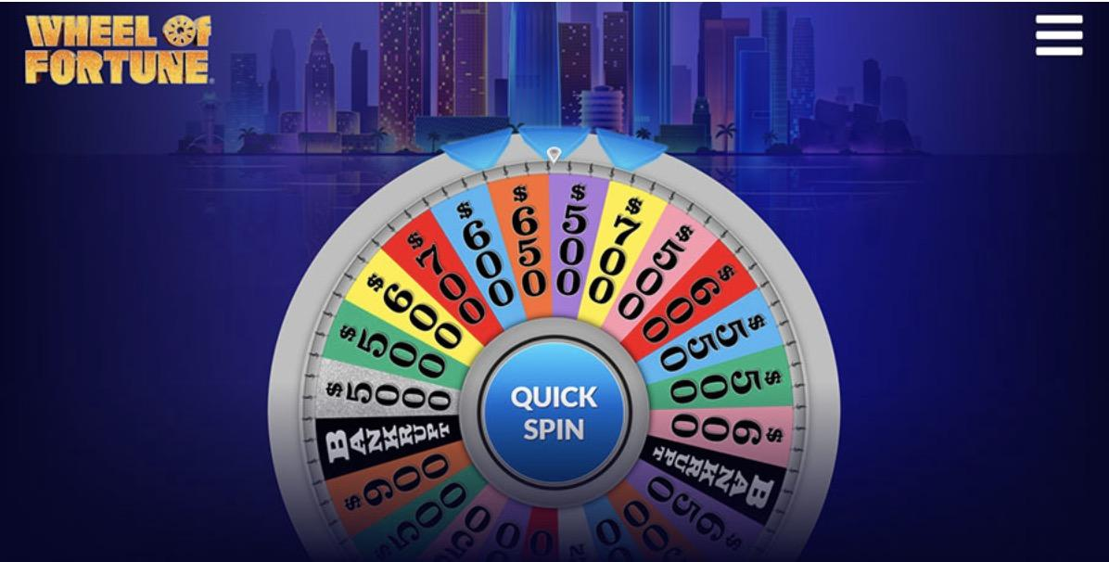
Wheel of Fortune® Performance Objective Alignment: The game places a premium on the fast retrieval of concepts, terminology, facts, and figures required for job performance.
Improved Skills: Concept connections, memorization, stress management.
Great for: Simple and short training points or terminology that need practice or repetition for memorization and engagement.
©2020 The Game Agency, LLC Confidential Information | Subscribers Only | All Rights Reserved
©2021 The Game Agency, LLC Confidential Information | Subscribers Only | All Rights Reserved

Slide 3
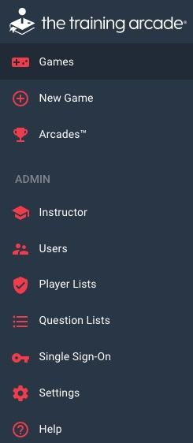
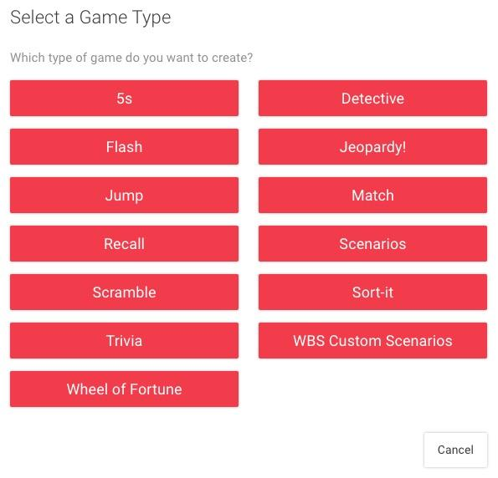
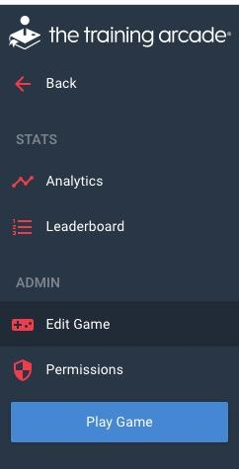
creating a game
To build a new game:
From navigation bar click “New Game”
Select “Wheel of Fortune” from the popup menu
©2021 The Game Agency, LLC Confidential Information | Subscribers Only | All Rights Reserved

Slide 4
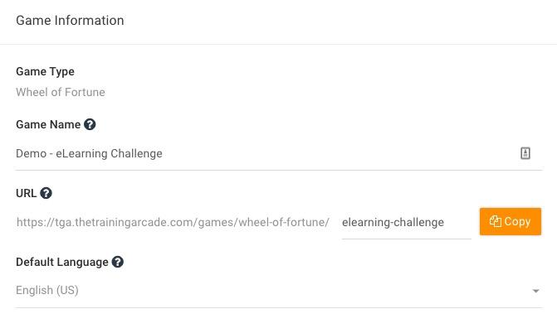
creating a game
Begin by clicking on the Game Info tab:
Game Name - Title by which the players will identify the game + game content.
URL - This field will auto-populate once you enter the game name
Default Language - English (US) is currently the only language available for the Wheel of Fortune game.
©2021 The Game Agency, LLC Confidential Information | Subscribers Only | All Rights Reserved

Slide 5
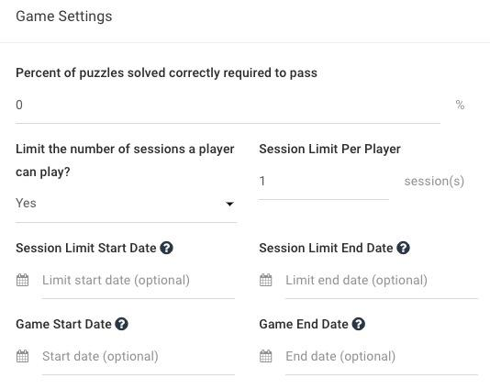
creating a game
Game Settings
In Wheel of Fortune, a pass % can be set for the entire game. Players must achieve the % entered here in order to receive the passing grade shown on the Game Over screen.
Creators can also set limits on how many times a player can attempt a game.
Set a start and end date for session play
Set a start and end date for game play
To watch a video detailing how these limits work <Click Here>
©2021 The Game Agency, LLC Confidential Information | Subscribers Only | All Rights Reserved

Slide 6
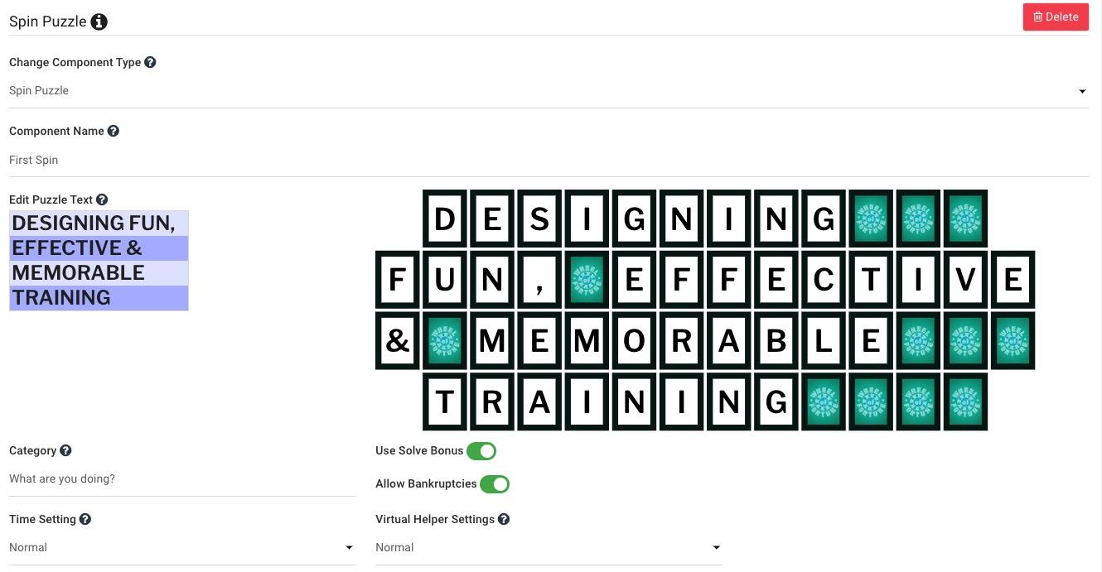
creating a game
Timer Settings
Time is set on the puzzle/component level in Wheel of Fortune.
There are 3 options for setting a solve time per puzzle/component
Slow
60 seconds
Normal
45 seconds aka Game Show Speed
Fast
30 seconds
©2021 The Game Agency, LLC Confidential Information | Subscribers Only | All Rights Reserved

Slide 7
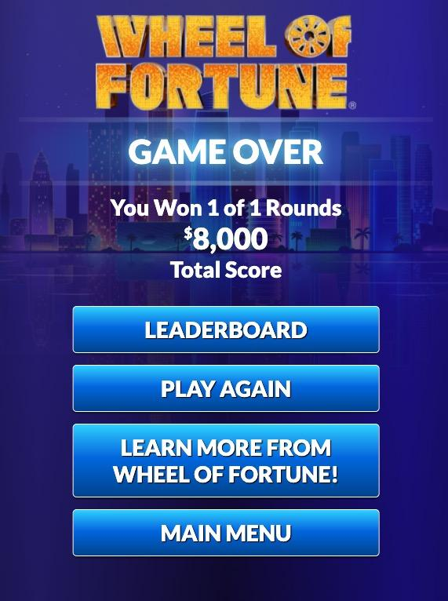
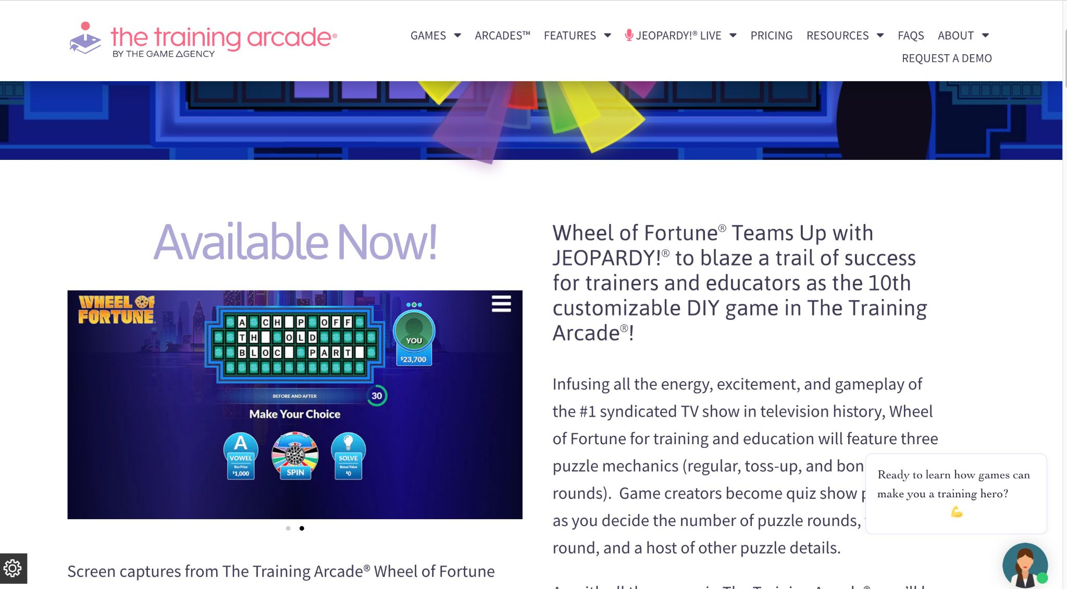
creating a game
Tutorial Settings
Show players a game tutorial prior to playing
Learn More
If you have an external link you would like to prompt players to visit once they complete the game, add a URL link here
The text on the Learn More button can be customized and made content specific in each game.
©2021 The Game Agency, LLC Confidential Information | Subscribers Only | All Rights Reserved

Slide 8
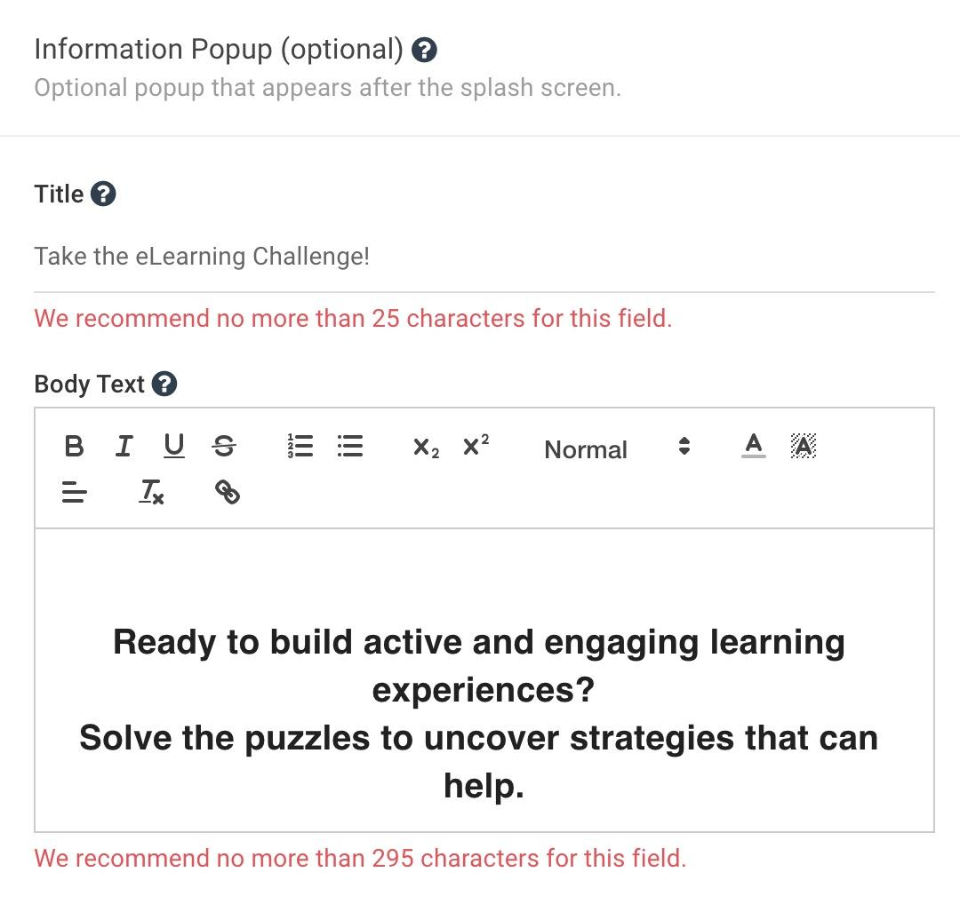
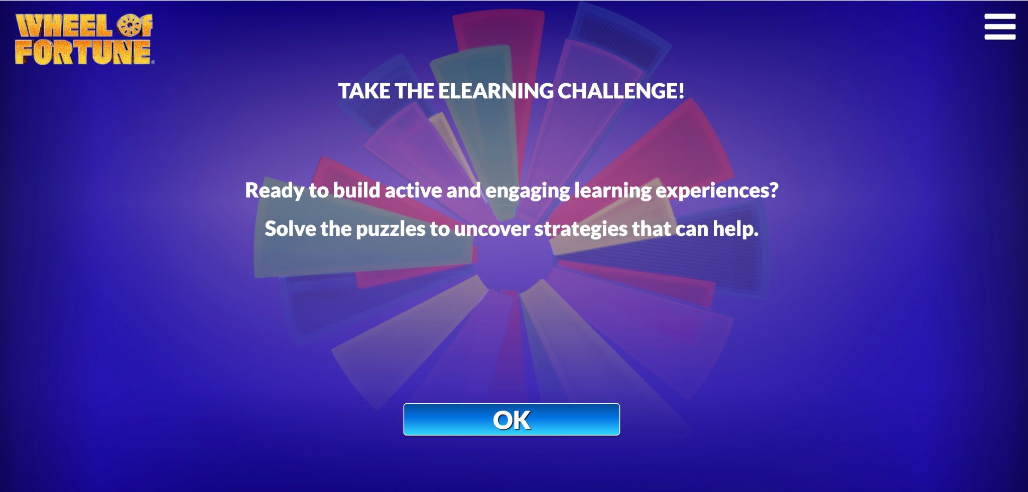
creating a game
Information Pop-Up
This feature is optional, but an extremely helpful tool to give your players an introduction to the game and material included within it.
There is a full text editor available for use when creating an <Info PopUp>
A text editor allows creators to have more options when entering the details to the “Body Text” such as changing font size, style or color.
©2021 The Game Agency, LLC Confidential Information | Subscribers Only | All Rights Reserved

Slide 9
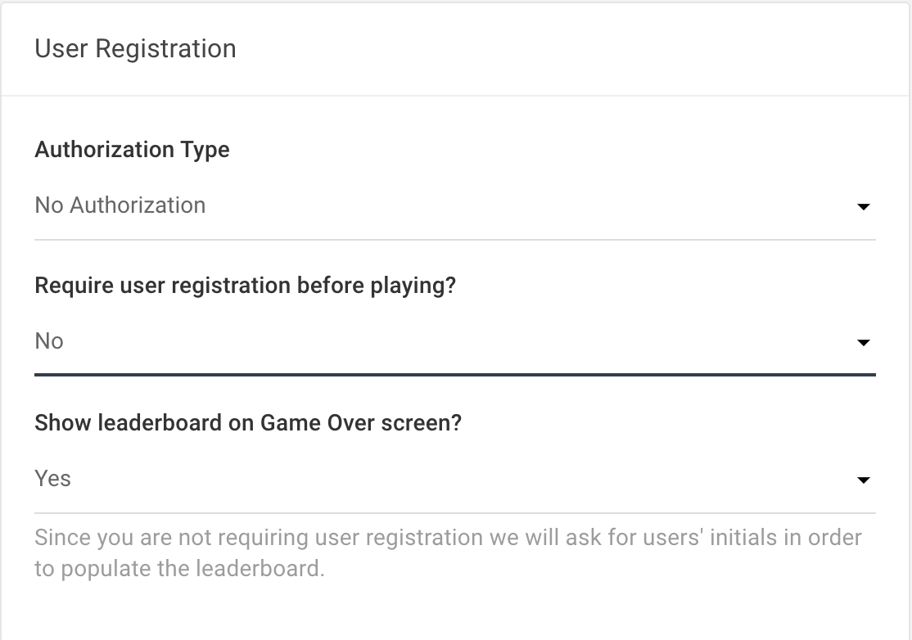
User Registration
Authorization Type:
No Authorization: Games are available to be played by anyone provided with the URL
Authorized Player List: Only players with emails on the list can access the URL
SSO (Single Sign On): Once SSO is connected to the account, the SSO becomes the access point and only players listed on the SSO can access the game.
©2021 The Game Agency, LLC Confidential Information | Subscribers Only | All Rights Reserved

Slide 10
User Registration
Authorization Type:
Authorized Player List (APL):
A player list can be created in Excel and loaded into the Admin portal using an Excel CSV file or manual data entry.
When an APL is in use, only players on the list can play the game. Anyone not approved to play will be presented with a black screen.
We have a separate User Guide available for adding an Authorized Player List to games
Please email Joanne.Vansteen@thegameagency.com to request a copy
©2021 The Game Agency, LLC Confidential Information | Subscribers Only | All Rights Reserved

Slide 11
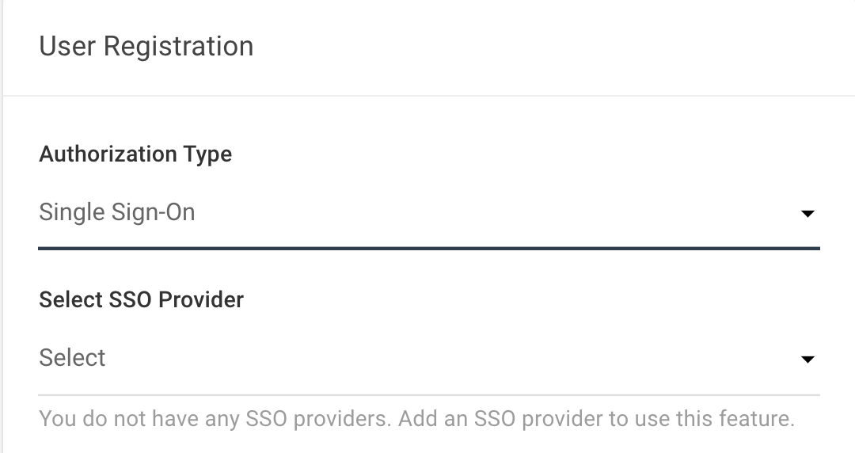
User Registration
Using Single Sign-On (SSO) - The Training Arcade supports SSO integration via SAML
You will need to add an idP (identity provider) to your subdomain in order to add SSO to a game.
Once an idP has been added to the subdomain, the provider will now be visible in this dropdown menu.
* If your IdP is not SAML compliant, we can work to customize the integration on a case by case basis. Please request a client consult in this event.
©2021 The Game Agency, LLC Confidential Information | Subscribers Only | All Rights Reserved

Slide 12
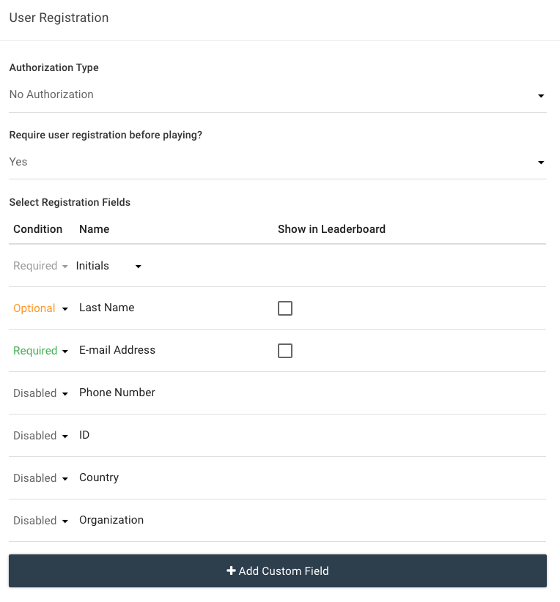
User Registration
If you require players to register prior to playing your game, toggle this field to “yes”.
When using registration, a unique identifier is required in The Training Arcade®. This is either Email or ID.
Up to 5 registration fields can be added to a leaderboard.
*When using initials the character limit is 30
We have a separate User Guide available for Custom Registration setup
Please email Joanne.Vansteen@thegameagency.com to request a copy
©2021 The Game Agency, LLC Confidential Information | Subscribers Only | All Rights Reserved

Slide 13
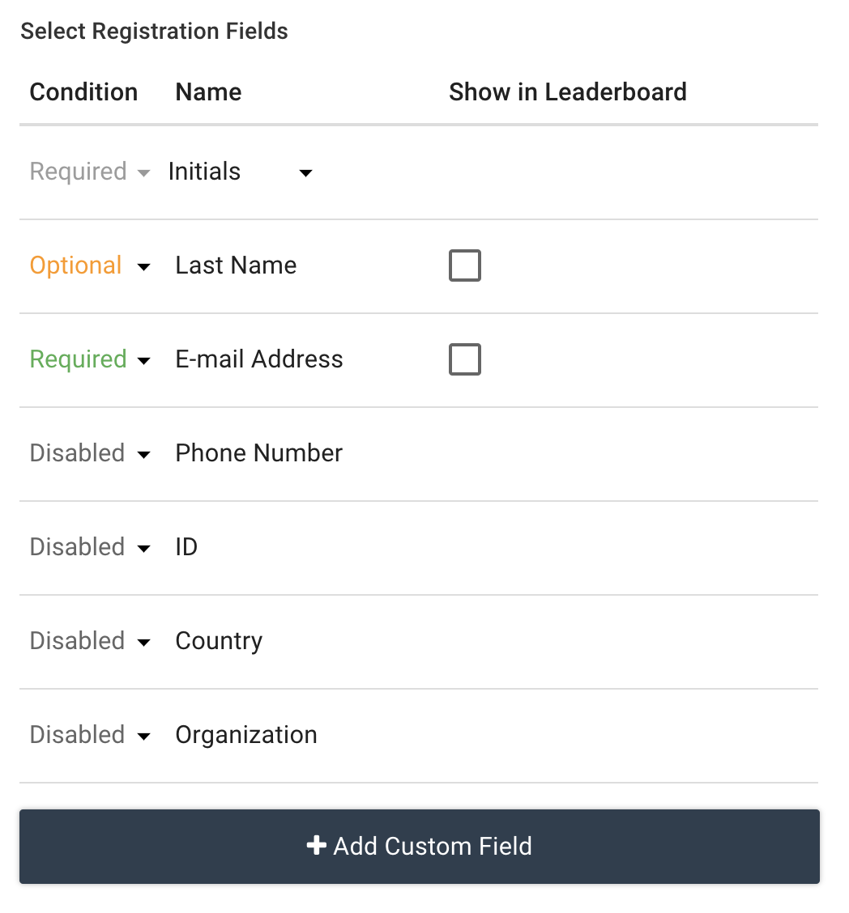
User Registration
User Registration - Custom Fields
Click on Add Custom Field and a new popup appears.
We have a separate User Guide available for Custom Registration setup
Please email Joanne.Vansteen@thegameagency.com to request a copy
©2021 The Game Agency, LLC Confidential Information | Subscribers Only | All Rights Reserved

Slide 14
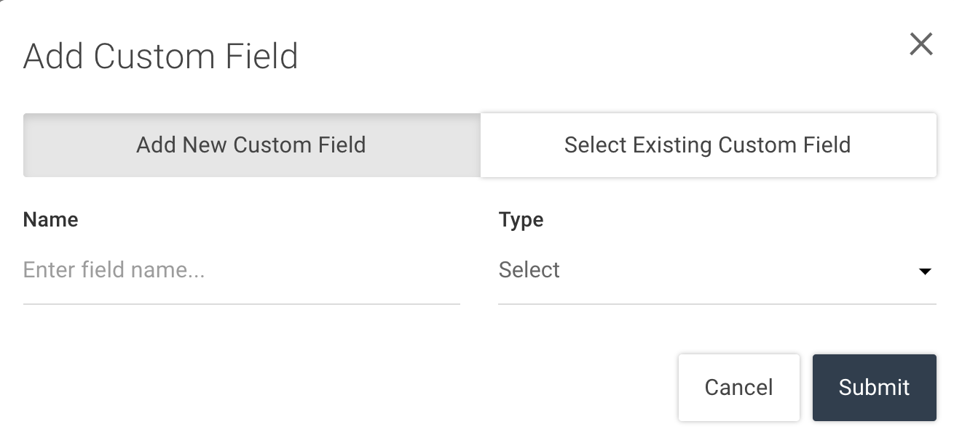
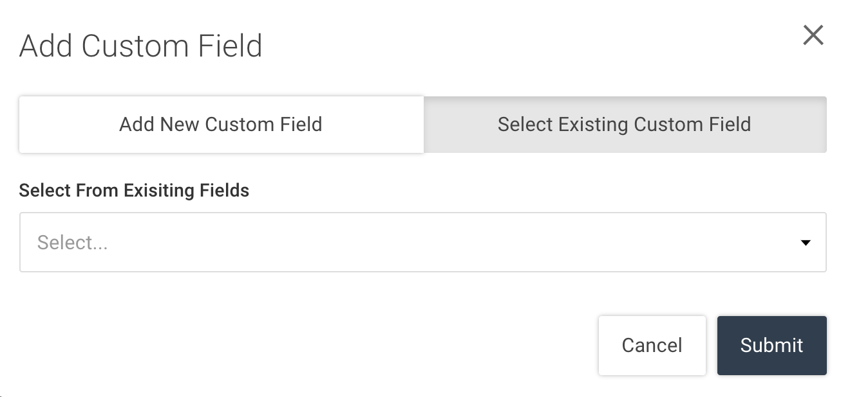
User Registration
User Registration - Custom Fields
Create a new custom field
or
Select existing custom field
The custom fields can also be included in the Game Over Leaderboard and analytics, by checking the “Show in leaderboard” box
We have a separate User Guide available for Custom Registration setup
Please email Joanne.Vansteen@thegameagency.com to request a copy
©2021 The Game Agency, LLC Confidential Information | Subscribers Only | All Rights Reserved

Slide 15
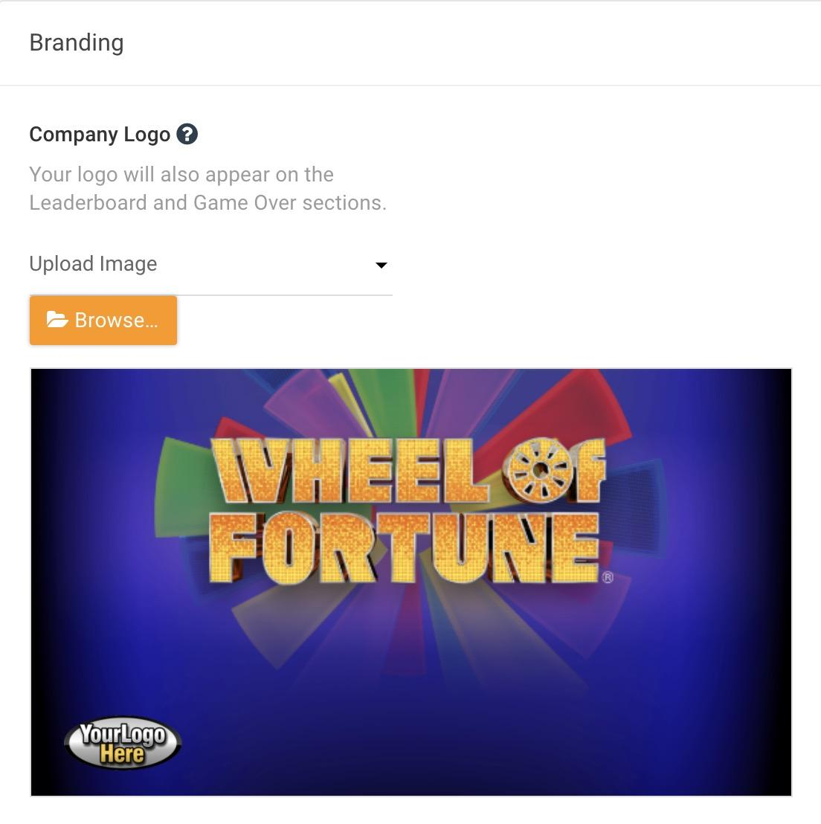
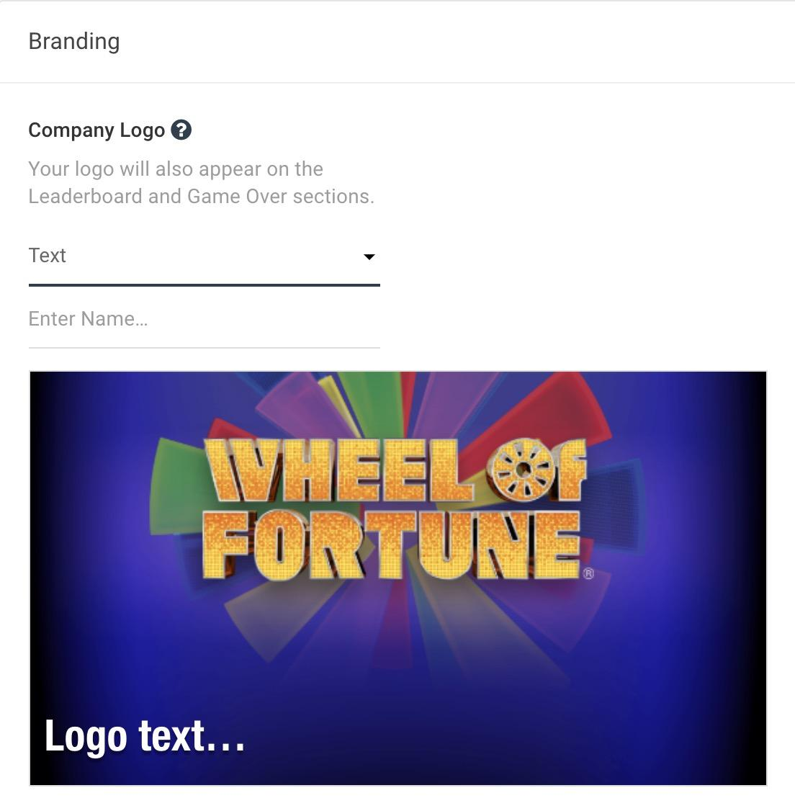
Splash Screen
Splash Screen
The Splash Screen is the first screen a player interacts with when they log in to play the game.
To customize your game, a company logo can be added here.
Upload your company logo
Add custom text
Locations and defaults are preset and cannot be changed without a custom theme.
©2021 The Game Agency, LLC Confidential Information | Subscribers Only | All Rights Reserved

Slide 16
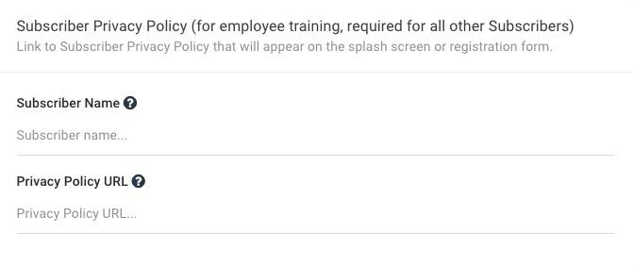
Privacy Policy
Adding a Subscriber Privacy Policy is optional and will add a link to the policy on the splash screen of the game.
Subscriber Name The name you wish to be displayed as part of the link.
Privacy Policy URL An active link that will take players to a copy of the privacy policy
©2021 The Game Agency, LLC Confidential Information | Subscribers Only | All Rights Reserved

Slide 17
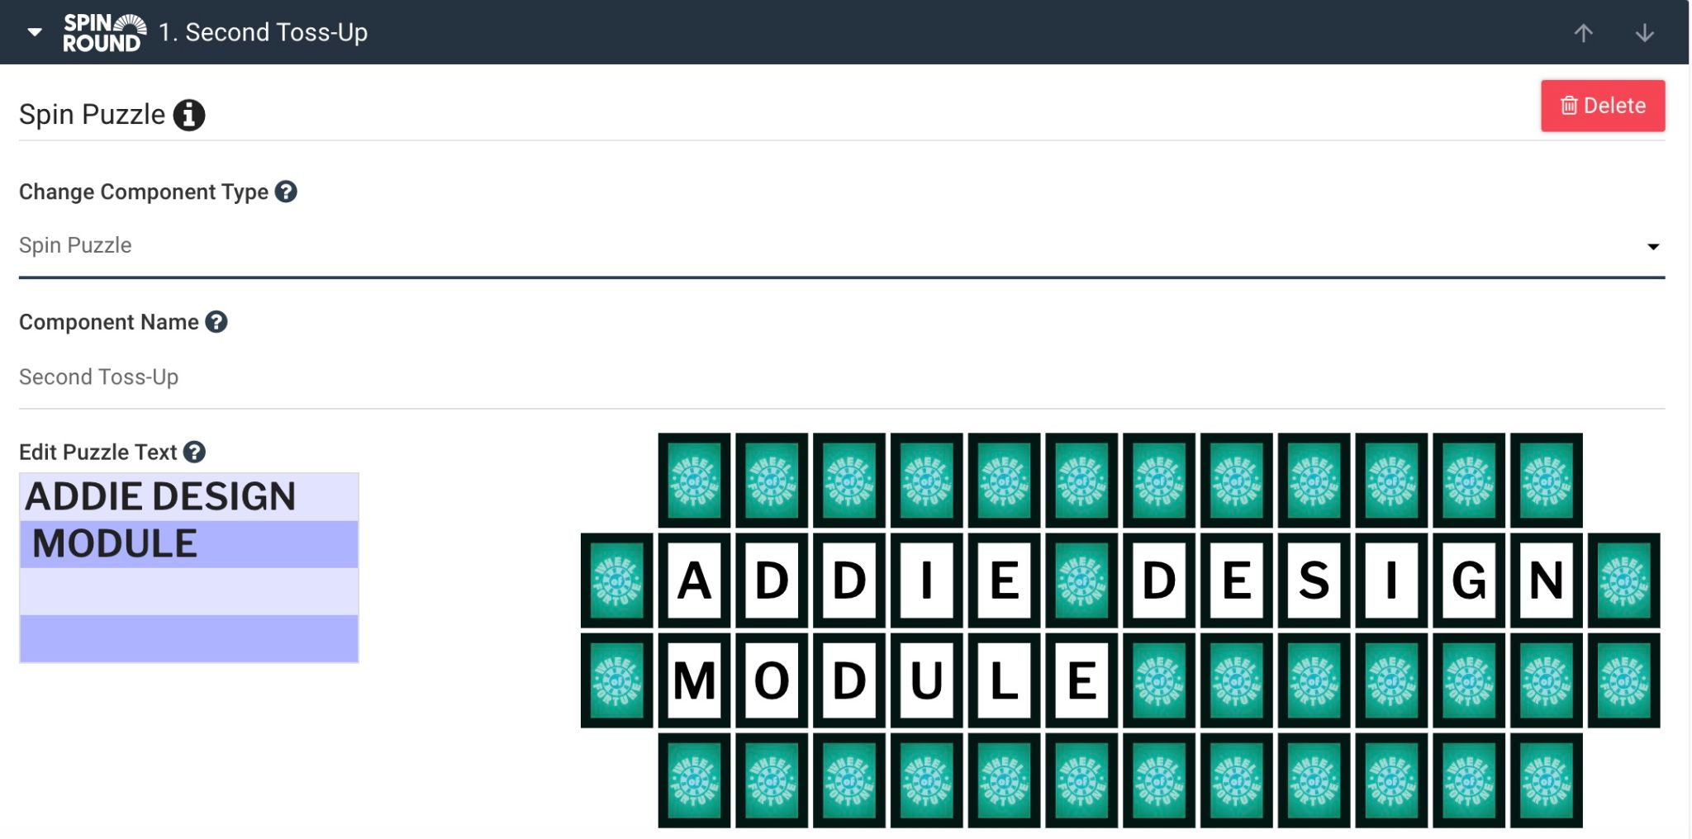
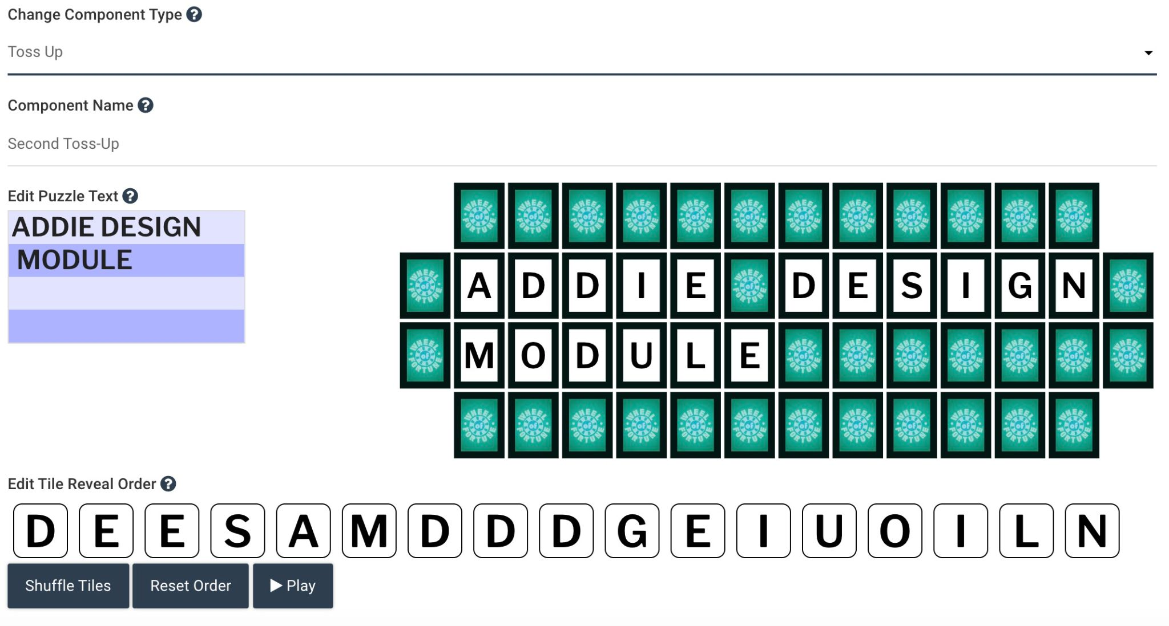
Component Types
Component or Puzzle Types
Spin Puzzle - The classic Wheel of Fortune game. Players spin the wheel for a chance to guess a letter. Use this for introductions, engagement and interest. It's fun to take a risk and figure out what letters are in a puzzle. If you want to assess performance, we recommend using the Toss Up or Bonus Round instead.
Toss Up - Letters are revealed one-by-one over time. Players guess the puzzle as soon as they can before all letters are revealed. This is great for assessment. We recommend putting it after a Spin Puzzle and/or after material to know if your learners retained that information.
©2021 The Game Agency, LLC Confidential Information | Subscribers Only | All Rights Reserved

Slide 18
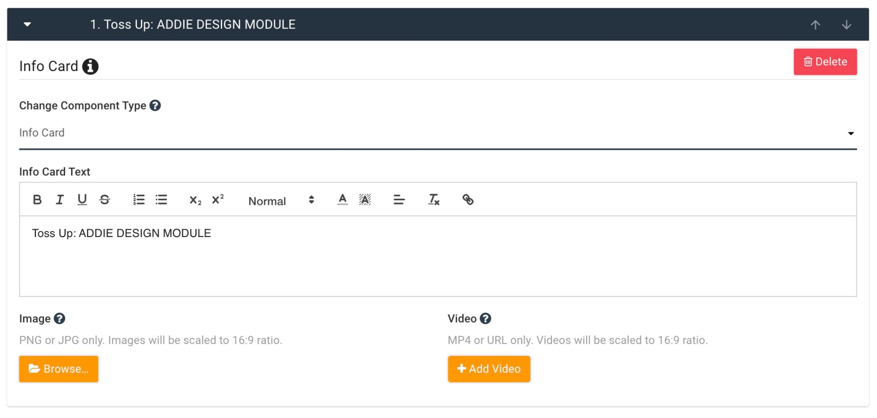
Component Types
Component or Puzzle Types
Bonus Round - The Bonus Round starts with a few letters (default is RSTLNE) revealed and/or you may allow players to select a few letters as clues. Players must solve the puzzle before the time is up. This is great for assessment and can provide a different format than Toss Up alone.
Info Card - Use this as a place to insert/display learning materials between puzzles or after each other. Here you can enter text and upload an image and/or a video.
©2021 The Game Agency, LLC Confidential Information | Subscribers Only | All Rights Reserved

Slide 19
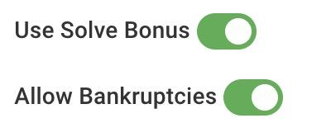
Additional Settings
Solve Bonus - Unlike the show, you can include a Solve Bonus for solving the puzzle early. The bonus amount is based on the number and rarity of letters within the puzzle and is reduced with each spin.
Allow Bankruptcies - The risk of landing on a Bankrupt space can add excitement to the game. Toggling this setting to off will remove <Bankrupt> from the spin board.
Virtual Helper - You can set how helpful the Virtual Helpers are to the player.
Easy - Give the best clues, buy vowels and miss common letters
Average - Some useful hints, but less accommodating
Hard - Competitive player, more contestant like than helpful assistants
©2021 The Game Agency, LLC Confidential Information | Subscribers Only | All Rights Reserved

Slide 20
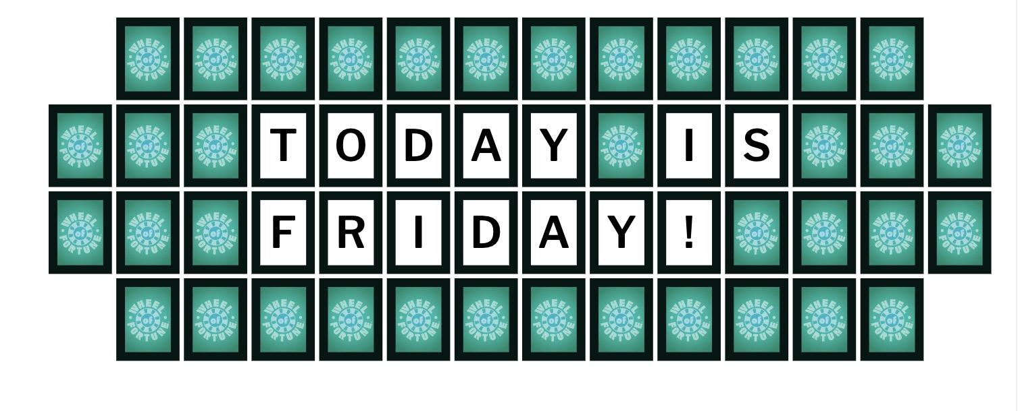
Additional Settings
Toss Up Puzzle
In the game show, letters automatically appear at intervals.
Click and drag these letters to change the order they are revealed.
Click <Shuffle> to change to a random order.
Click <Reset Order> to return the letters to the original order.
Click <Play> to preview how the letters will reveal in the game.
©2021 The Game Agency, LLC Confidential Information | Subscribers Only | All Rights Reserved

Slide 21
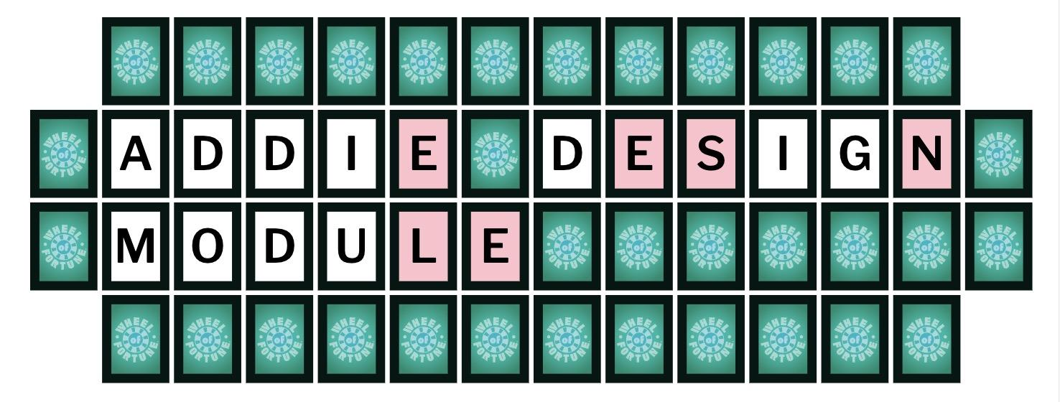
Additional Settings
Bonus Round Puzzle
Letters Revealed - These are preset letters that are revealed to the player before they solve the puzzle.
RSTLNE are the defaults provided on the game show, in our game mechanic these letters can be edited.
Consonant Guess Allowed - Up to 5 consonant guesses can be allowed.
Vowel Guesses Allowed - Vowel guesses allowed can be set to 1 or 0
©2021 The Game Agency, LLC Confidential Information | Subscribers Only | All Rights Reserved

Slide 22
Thank you for viewing this step-by-step guide on how to create a
Wheel of Fortune® Game
For more information, email joanne.vansteen@thegameagency.com
©2021 The Game Agency, LLC Confidential Information | Subscribers Only | All Rights Reserved

